Slide 1

Revenue Forecasting for Subscription-Based Service
Arunima K

Slide 2

Introduction
Here mainly analyzes subscription revenue trends, payment methods and churn rates to understand business performance.
It helps predict future revenue fluctuations and take necessary actions to improve retention and profitability

Slide 3
Dataset Overview
This dataset contains key attributes like revenue, churn rate, payment methods and customer status, essential for analyzing subscription trends.
By examining these attributes, we can track revenue patterns, forecast future earnings, and assess factors influencing customer retention.

Slide 4

Dashboard Overview

Slide 5
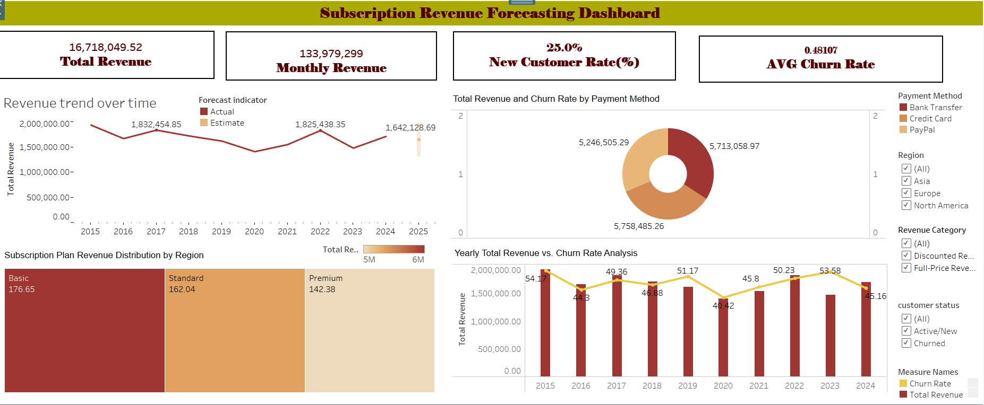

Slide 6
Key Insights
The Basic Plan generates the highest revenue, while the Premium Plan contributes the least, indicating a stronger preference for affordability.
A higher churn rate negatively impacts revenue, as seen in 2023, emphasizing the importance of customer retention strategies.
Revenue is evenly distributed across payment methods, with PayPal slightly leading, suggesting a need to analyze churn trends by payment method.
Revenue has fluctuated over the years, with declines in 2018, 2019, and 2023, highlighting the need for promotions, retention programs and market expansion.

Slide 7
Conclusion
Here high churn rates and revenue fluctuations emphasize the need for strong customer retention strategies.
To ensure future growth, businesses should optimize pricing, enhance payment flexibility and explore new market opportunities.

